Slide 1



PPT-1
PROJECT
Hospital Management System
Batch : BSC.IT 5A
Name : Sumitkumar Pandit
ER. No. : IU2283830051
Guided By : Ms. Mansi Mehta

Slide 2


Content
01
02
03
04
05
Introduction
Scope of the System
Modules
Tools & Technology
Analysis:
Needs of System
System Flow diagram

Slide 3


01
Introduction
Welcome to our presentation on the Hospital Management System (HMS). This system is designed to make running a hospital easier and more efficient. It helps with managing patient information, scheduling appointments, handling billing, and keeping track of hospital supplies.
Today, we'll show you how our HMS works, the key features it offers, and how it can help improve the day-to-day operations of a hospital.

Slide 4

02
Scope of System
Improve patient care and streamline hospital operations.
Enhance administrative efficiency and reduce paperwork.
Ensure secure and accurate patient information management.
Provide real-time data and analysis for decision-making.
Integrate various hospital departments for seamless operation.

Slide 5

03
Modules
01
02
03
04
Patient Management
Appointment Scheduling
Billing and Payments
Inventory Management
Registration
- Managing Patient Information and History
- Scheduling and Managing Appointments
- Notifications and Reminders A/R
Invoice Generation
- Payment Processing and Management
- Tracking Medicines and Medical Supplies
- Procurement and Stock Management
05
06
07
08
Medical Records
Reporting and Analytics
Admin Management
Doctor Management
- Electronic Health Records (EHR)
- Managing Patient Medical Records and Treatment Plans
- Generating Various Reports
- Data Analysis for Decision Making
- Compliance and Regulatory Reporting
Patient Management
Doctor management
Room Management
Customization access
Registration
Performance tracking
Access control A/R
-View history

Slide 6

04
Tools & Technology
Front – end Development
Back – end
Development
Database
Tool
Java Scripts
PHP
HTML(PHP)
CSS(Bootstrap)
Java Scripts
MySQL
VS code
Sublime text
Draw. Io

Slide 7
05
Needs of System
Make Work Easier: Automate tasks like patient registration, appointment scheduling, and billing to save time and reduce paperwork.
Better Patient Care: Quickly access patient information to make informed decisions and coordinate care between departments.
Keep Accurate Records: Maintain centralized and accurate patient records that are easy to access.
Manage Resources: Track medical supplies, equipment, and staff schedules efficiently.
Handling Transaction: Simplify billing and payments, and manage transactions accurately.
Follow Rules: Ensure compliance with healthcare regulations and standards.
Protect Data: Secure patient data and ensure privacy.
Get Insights: Generate reports and analyze data to monitor performance and make better decisions.
Improve Patient Experience: Provide better service through efficient scheduling, billing, and communication with patients.

Slide 8


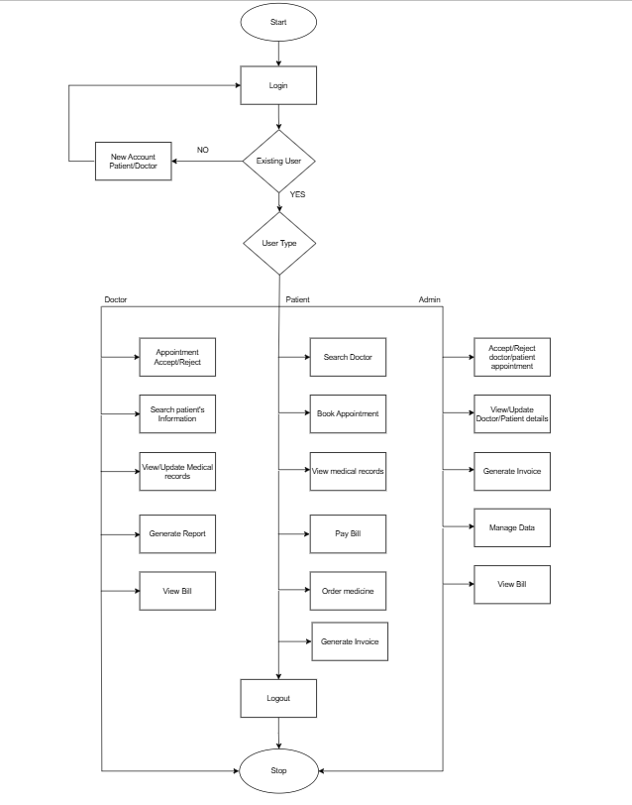
06
System Flow diagram

Slide 9



presentation 2

Slide 10

Topics Covered
UML Diagram
HMS
Data Dictionary
UI Screenshots

Slide 11
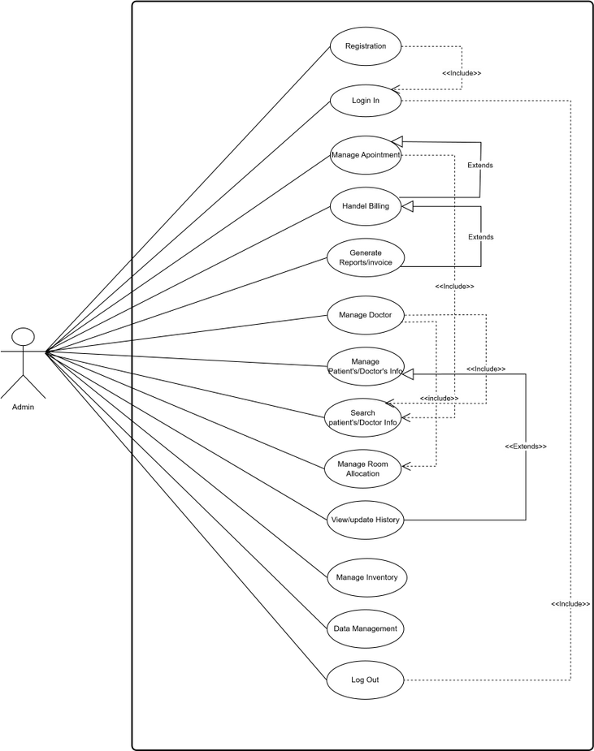
UML Diagram
Use-case Admin

Slide 12
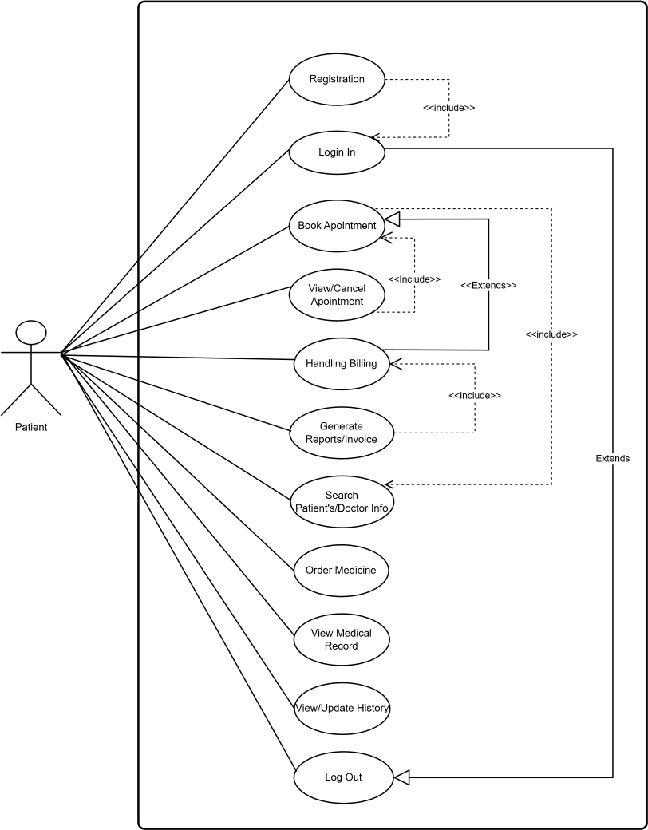
Use-case Patient

Slide 13
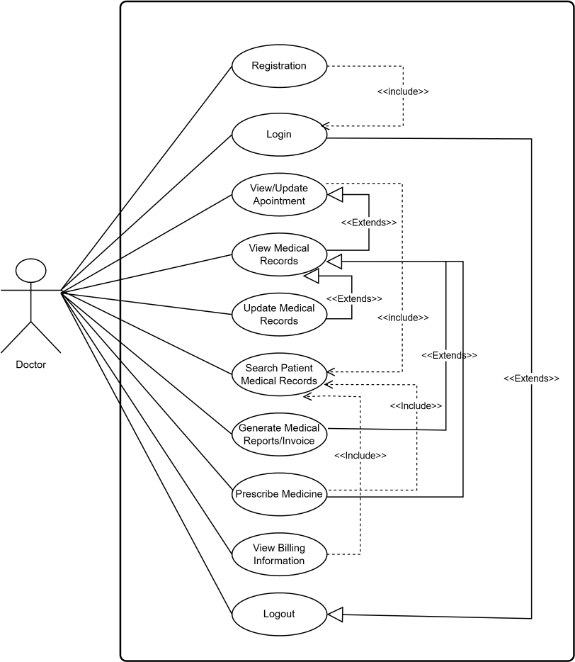
Use-case Doctor

Slide 14
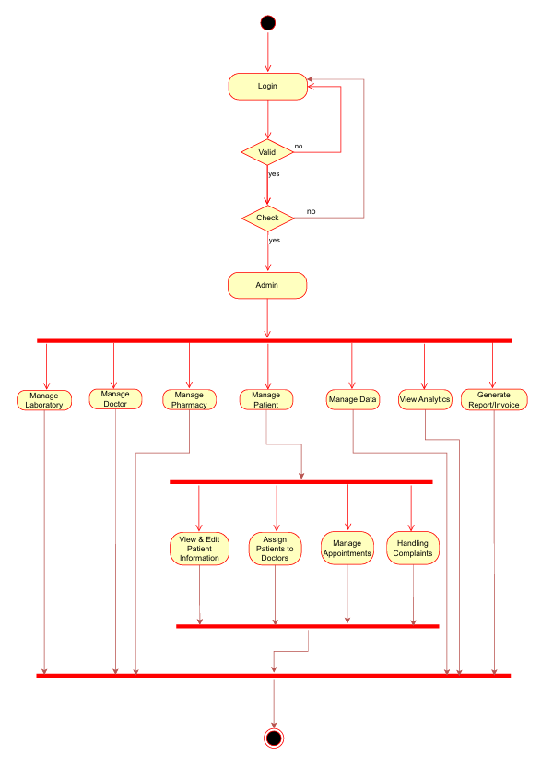
Activity Diagram Admin

Slide 15
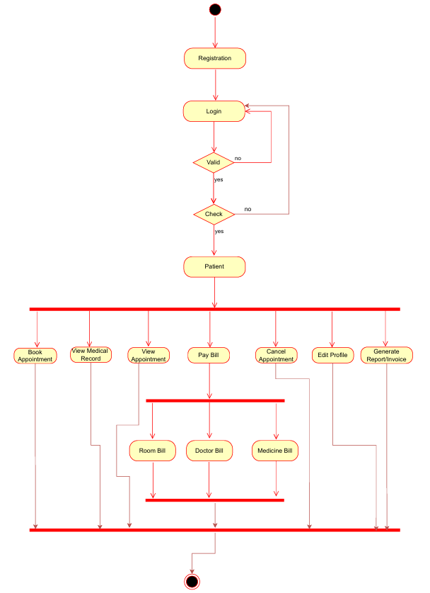
Activity Diagram Patient

Slide 16
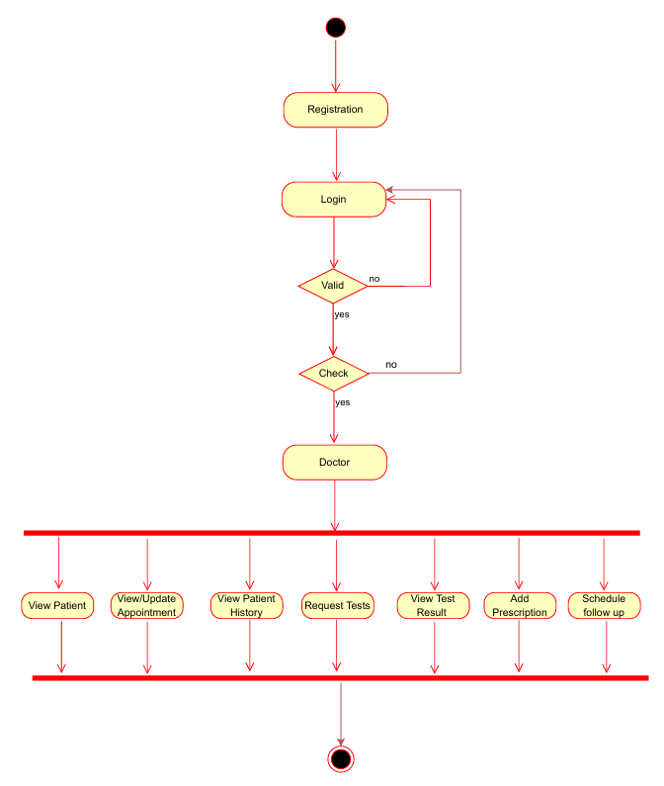
Activity Diagram Doctor

Slide 17
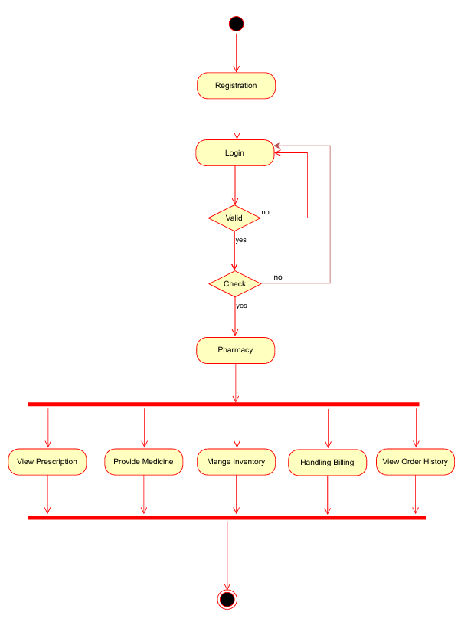
Activity Diagram Pharmacy

Slide 18
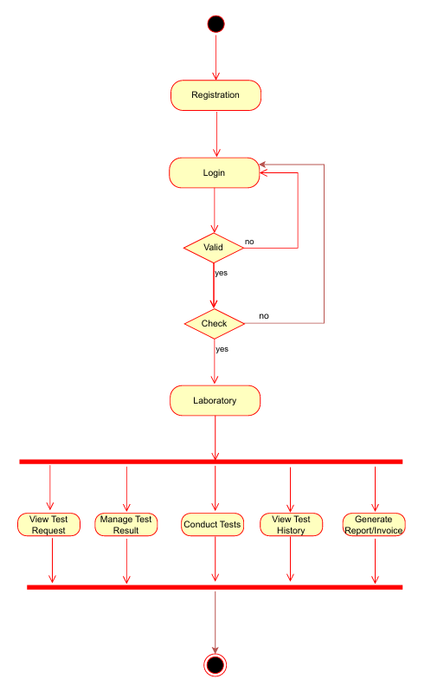
Activity Diagram Laboratory

Slide 19
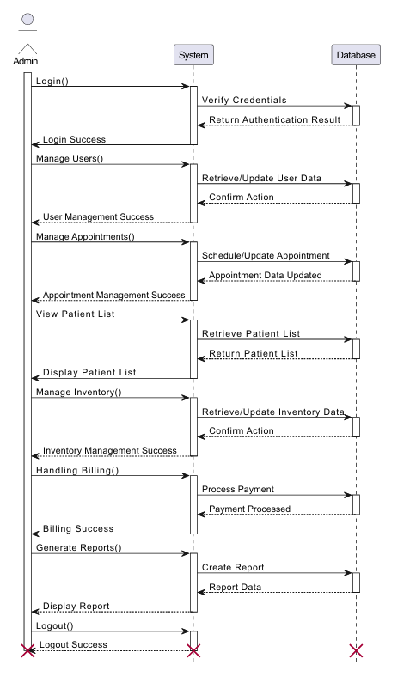
Sequence Diagram Admin

Slide 20
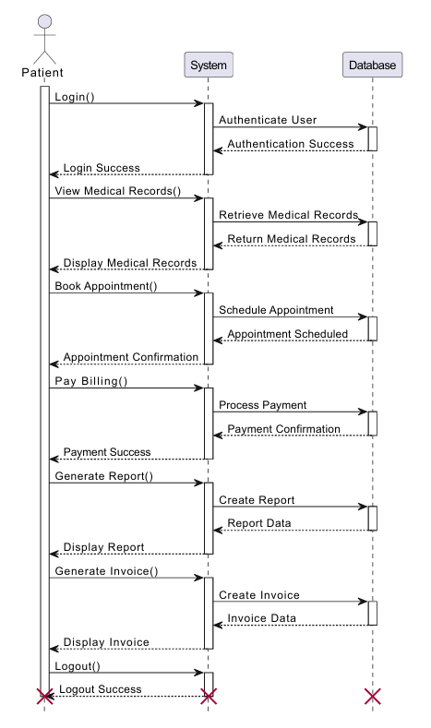
Sequence Diagram Patient

Slide 21
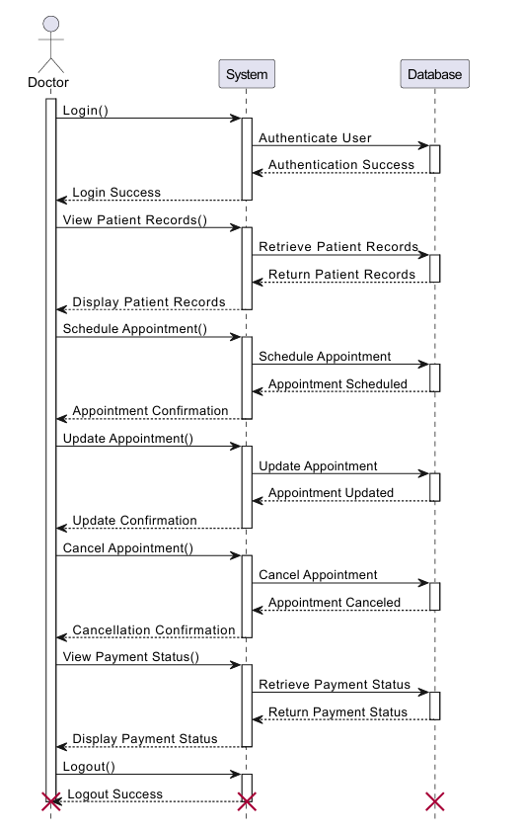
Sequence Diagram Docter

Slide 22
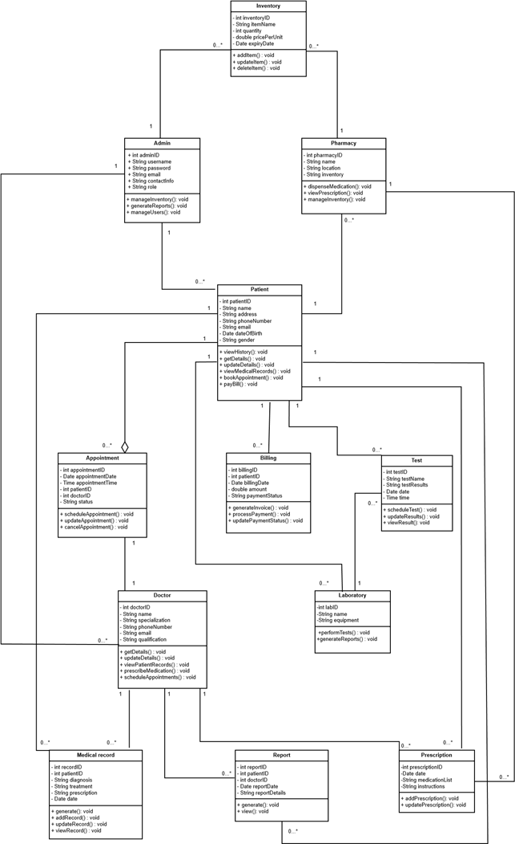
Class Diagram

Slide 23
Data Dictionary
Patient Table
Field Name | Data Type | Size | Description | Constraints
patientID | INT | 4 bytes | Unique identifier for patient | Primary Key, Auto Increment
name | VARCHAR | 50 | Patient's name | Not Null
address | VARCHAR | 120 | Patient's address | Not Null
phoneNumber | VARCHAR | 15 | Patient's phone number | Not Null
email | VARCHAR | 50 | Patient's email address | Not Null
dateOfBirth | DATE | 3 bytes | Patient's date of birth | Not Null
gender | ENUM | 1 byte | Patient's gender | Values: Male, Female, Other

Slide 24
Data Dictionary
Doctor Table
Field Name | Data Type | Size | Description | Constraints
doctorID | INT | 4 bytes | Unique identifier for doctor | Primary Key, Auto Increment
name | VARCHAR | 50 | Doctor's name | Not Null
specialization | VARCHAR | 50 | Doctor's specialization | Not Null
phoneNumber | VARCHAR | 15 | Doctor's phone number | Not Null
email | VARCHAR | 50 | Doctor's email address | Not Null
qualification | VARCHAR | 50 | Doctor's qualification | Not Null

Slide 25
Data Dictionary
Appointment Table
Field Name | Data Type | Size | Description | Constraints
appointmentID | INT | 4 bytes | Unique identifier for appointment | Primary Key, Auto Increment
appointmentDate | DATE | 3 bytes | Date of appointment | Not Null
appointmentTime | TIME | 3 bytes | Time of appointment | Not Null
patientID | INT | 4 bytes | Related patient ID | Foreign Key
doctorID | INT | 4 bytes | Related doctor ID | Foreign Key
status | VARCHAR | 20 | Status of appointment (e.g., Accept/reject) | Not Null
appointmentType | VARCHAR | 30 | Type of appointment (e.g., "Consultation", "Follow-up") | NULL

Slide 26
Data Dictionary
MedicalRecord Table
Field Name | Data Type | Size | Description | Constraints
recordID | INT | 4 bytes | Unique identifier for record | Primary Key, Auto Increment
patientID | INT | 4 bytes | Related patient ID | Foreign Key
diagnosis | TEXT | N/A | Patient's diagnosis details | Not Null
treatment | TEXT | N/A | Patient's treatment details | Not Null
prescription | TEXT | N/A | Prescription details | Not Null
date | DATE | 3 bytes | Date of record | Not Null

Slide 27
Data Dictionary
Billing Table
Field Name | Data Type | Size | Description | Constraints
billingID | INT | 4 bytes | Unique identifier for billing | Primary Key, Auto Increment
patientID | INT | 4 bytes | Related patient ID | Foreign Key
billingDate | DATE | 3 bytes | Date of billing | Not Null
amount | DECIMAL | 10,2 | Billing amount | Not Null
paymentStatus | VARCHAR | 20 | Status of payment | Not Null

Slide 28
Data Dictionary
Inventory Table
Field Name | Data Type | Size | Description | Constraints
inventoryID | INT | 4 bytes | Unique identifier for inventory | Primary Key, Auto Increment
itemName | VARCHAR | 100 | Name of the item | Not Null
quantity | INT | 4 bytes | Quantity available | Not Null
pricePerUnit | DECIMAL | 10,2 | Price per unit of item | Not Null
expiryDate | DATE | 3 bytes | Expiry date of item | Not Null

Slide 29
Data Dictionary
Report Table
Field Name | Data Type | Size | Description | Constraints
reportID | INT | 4 bytes | Unique identifier for report | Primary Key, Auto Increment
patientID | INT | 4 bytes | Related patient ID | Foreign Key
doctorID | INT | 4 bytes | Related doctor ID | Foreign Key
reportDate | DATE | 3 bytes | Date of report | Not Null
reportDetails | TEXT | N/A | Details of the report | Not Null

Slide 30
Data Dictionary
Admin Table
Field Name | Data Type | Size | Description | Constraints
adminID | INT | 4 bytes | Unique identifier for admin | Primary Key, Auto Increment
username | VARCHAR | 50 | Admin username | Not Null
password | VARCHAR | 50 | Admin password (hashed) | Not Null
role | VARCHAR | 3 | Role of the admin | Not Null

Slide 31
Data Dictionary
Pharmacy Table
Field Name | Data Type | Size | Description | Constraints
pharmacyID | INT | 4 bytes | Unique identifier for pharmacy | Primary Key, Auto Increment
name | VARCHAR | 50 | Name of the pharmacy | Not Null
inventory | TEXT | N/A | Inventory details | Not Null

Slide 32
Data Dictionary
Laboratory Table
Field Name | Data Type | Size | Description | Constraints
labID | INT | 4 | Unique identifier for lab center | Primary Key, Auto Increment
name | VARCHAR | 50 | Name of the lab center | Not Null
equipment | TEXT | N/A | Equipment details | Not Null

Slide 33
Data Dictionary
Test Table
Field Name | Data Type | Size | Description | Constraints
testID | INT | 4 bytes | Unique identifier for test | Primary Key, Auto Increment
testName | VARCHAR | 100 | Name of the test | Not Null
testResults | TEXT | N/A | Results of the test | Not Null
date | DATE | 3 bytes | Date of the test | Not Null
time | TIME | 3 bytes | Time of the test | Not NUll

Slide 34
Data Dictionary
Prescription Table
Field Name | Data Type | Size | Description | Constraints
prescriptionID | INT | 4 | Unique identifier for prescription | Primary Key, Auto Increment
date | DATE | 3 | Date of the prescription | Not Null
medicationList | TEXT | N/A | List of medications | Not Null
instructions | TEXT | N/A | Additional instructions | Not Null

Slide 35

UI Screenshots
Home Page

Slide 36
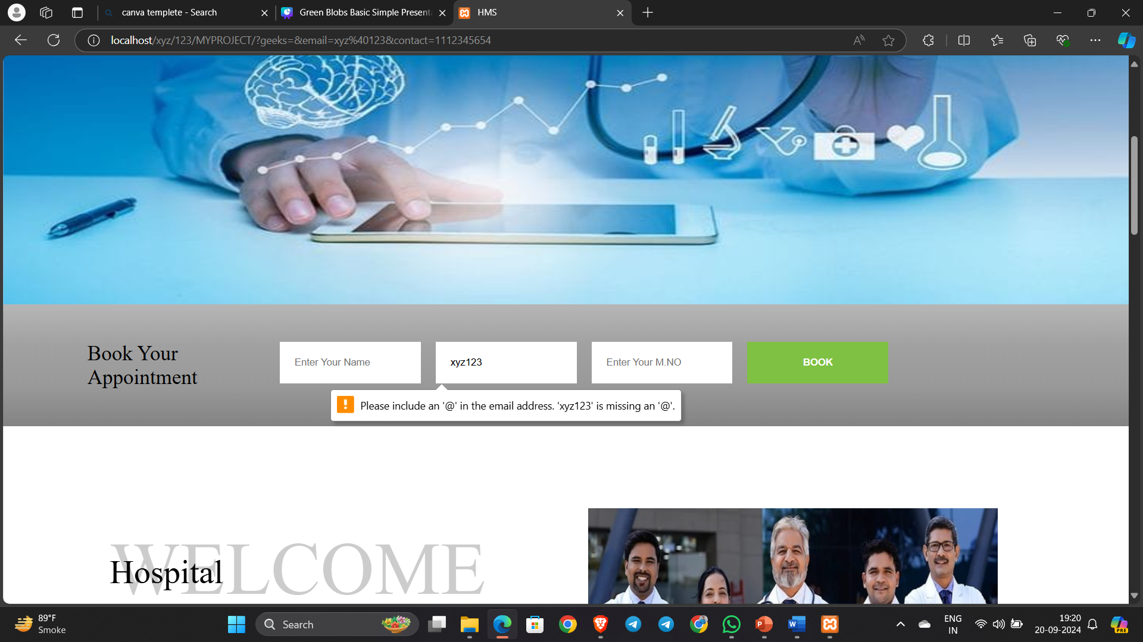
validation on appointment

Slide 37
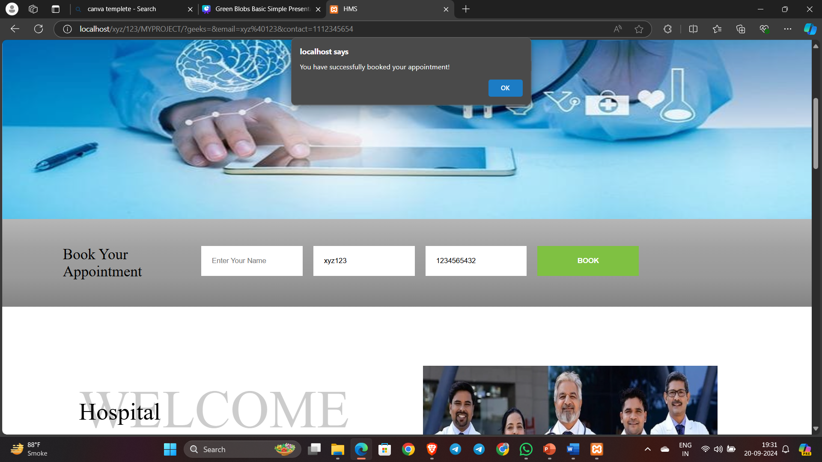
validation on appointment

Slide 38
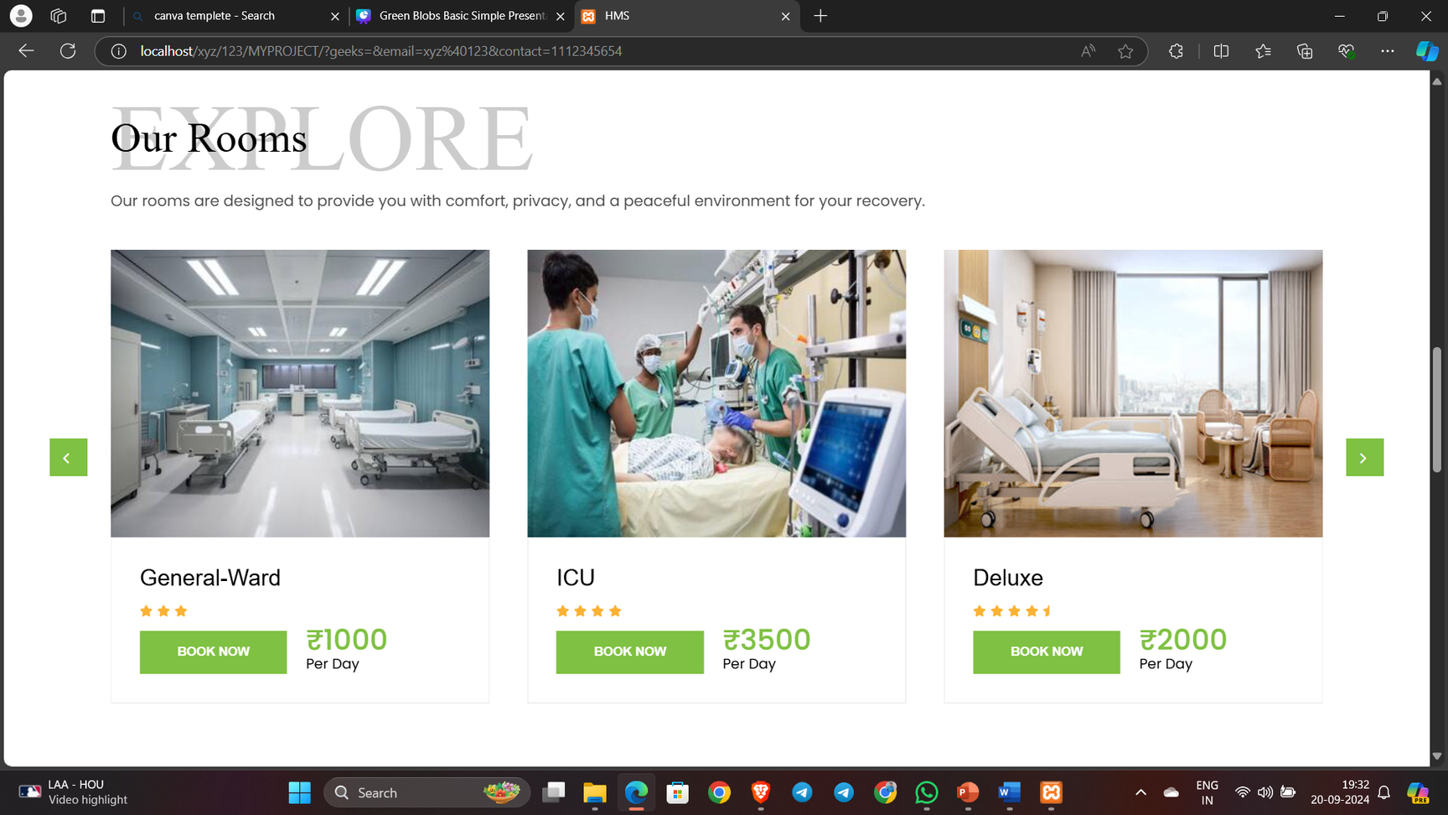
Our Rooms

Slide 39
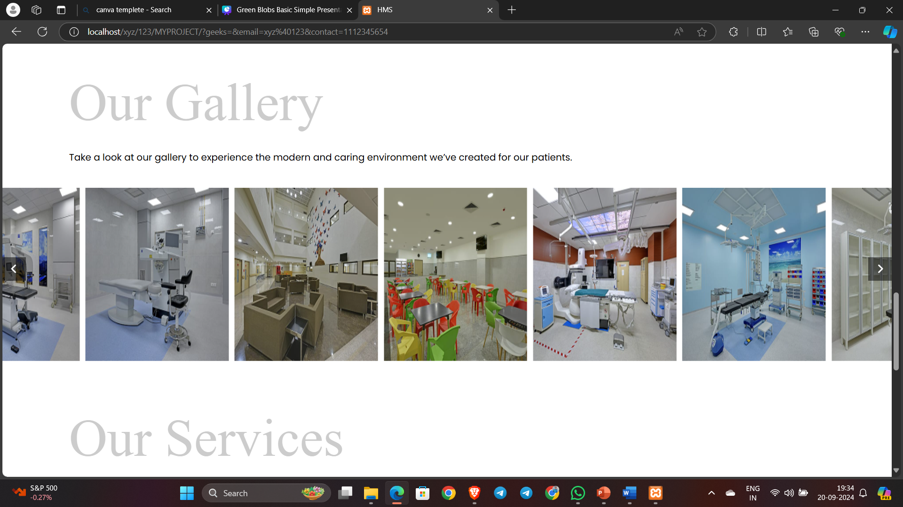
Our Gallery

Slide 40
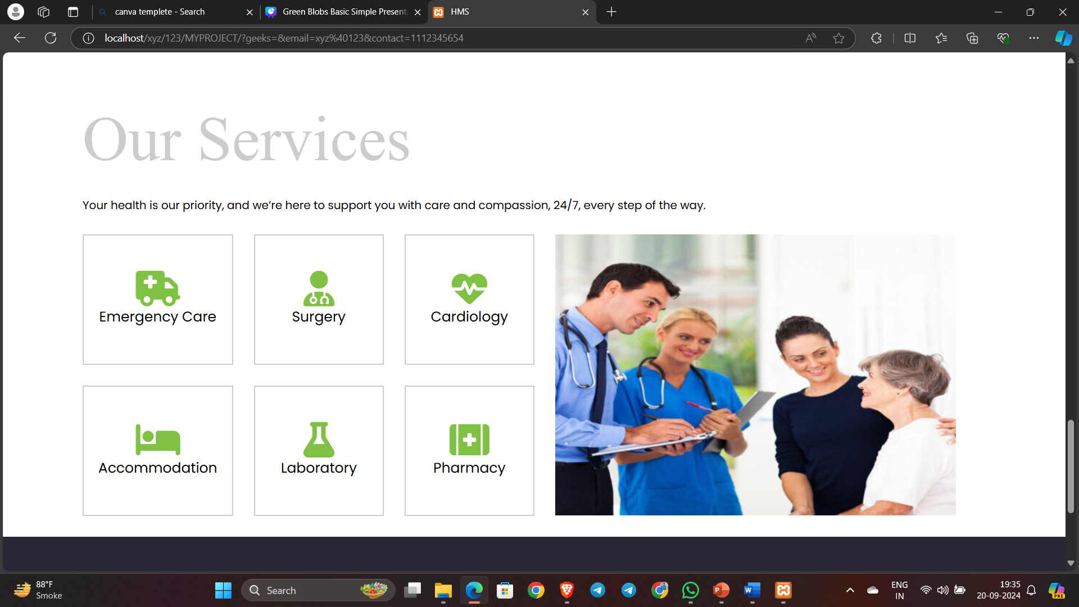
Our Services

Slide 41
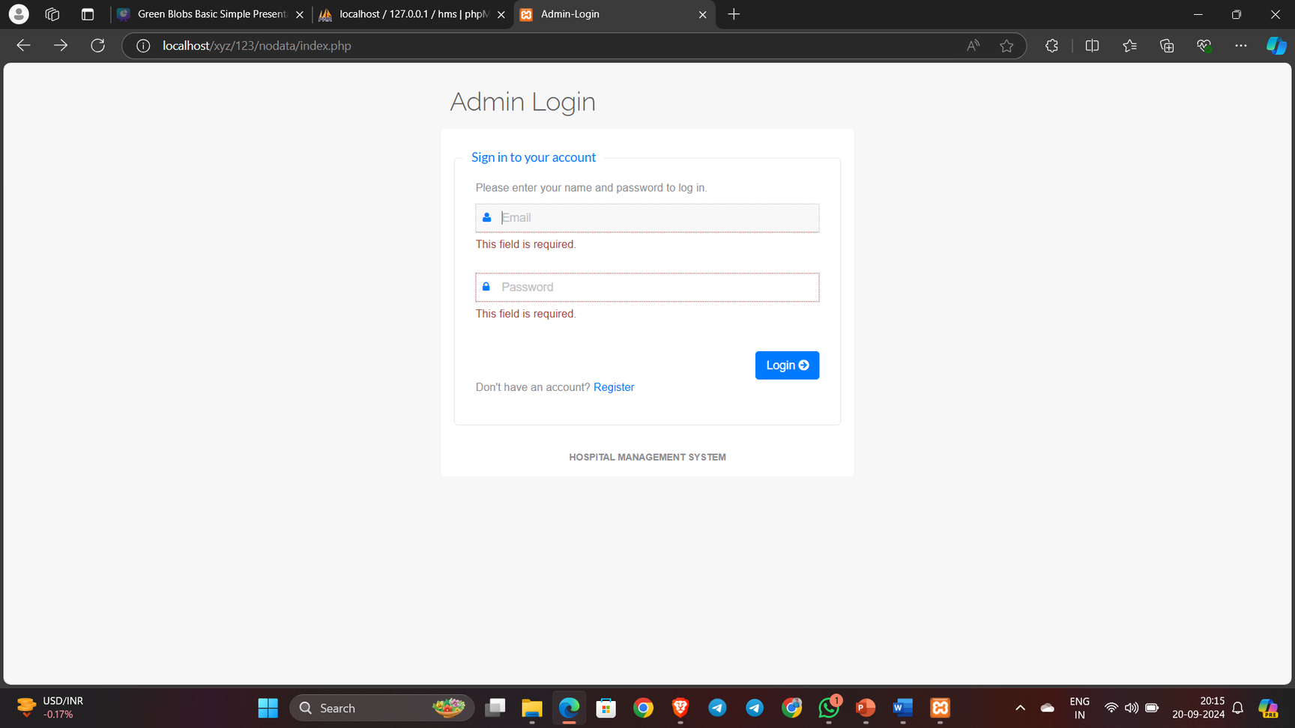
Login Page

Slide 42
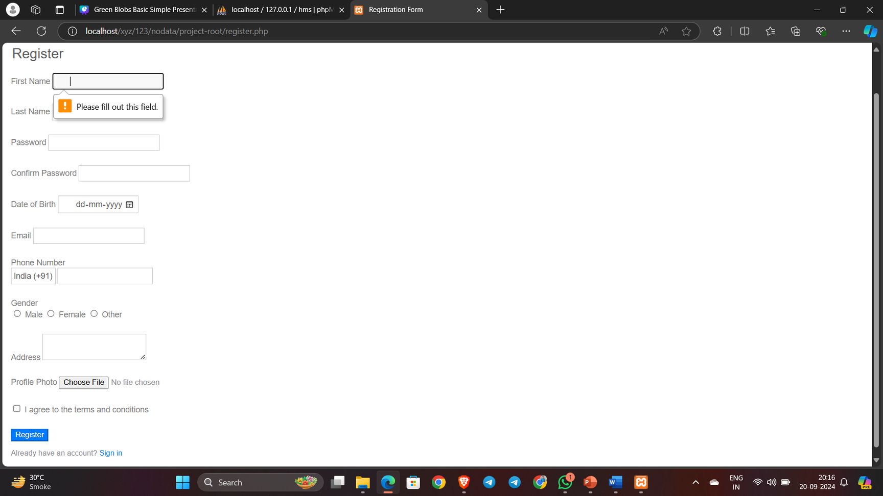
Register Page

Slide 43
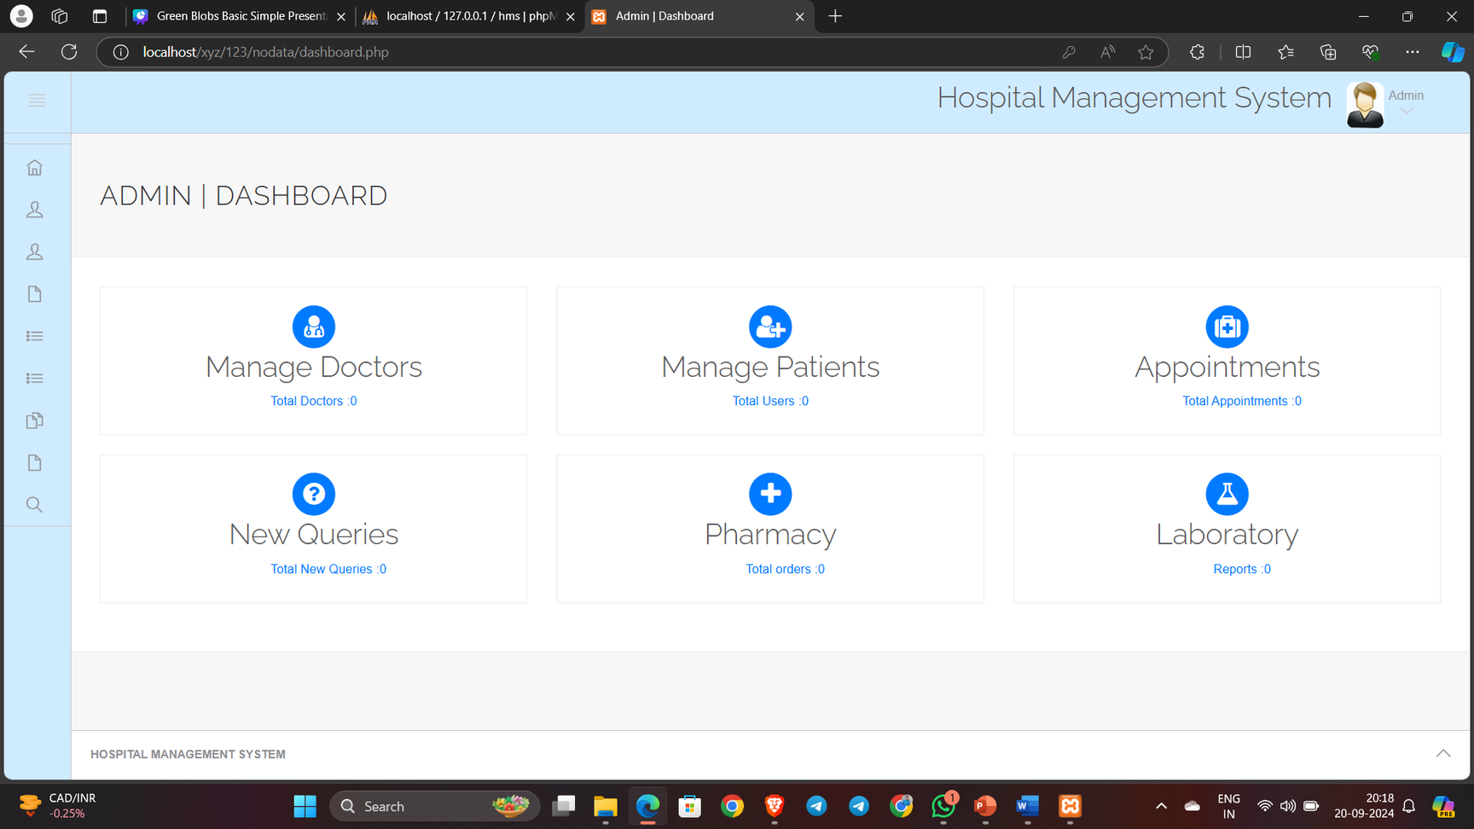
Dashboard Admin Page

Slide 44
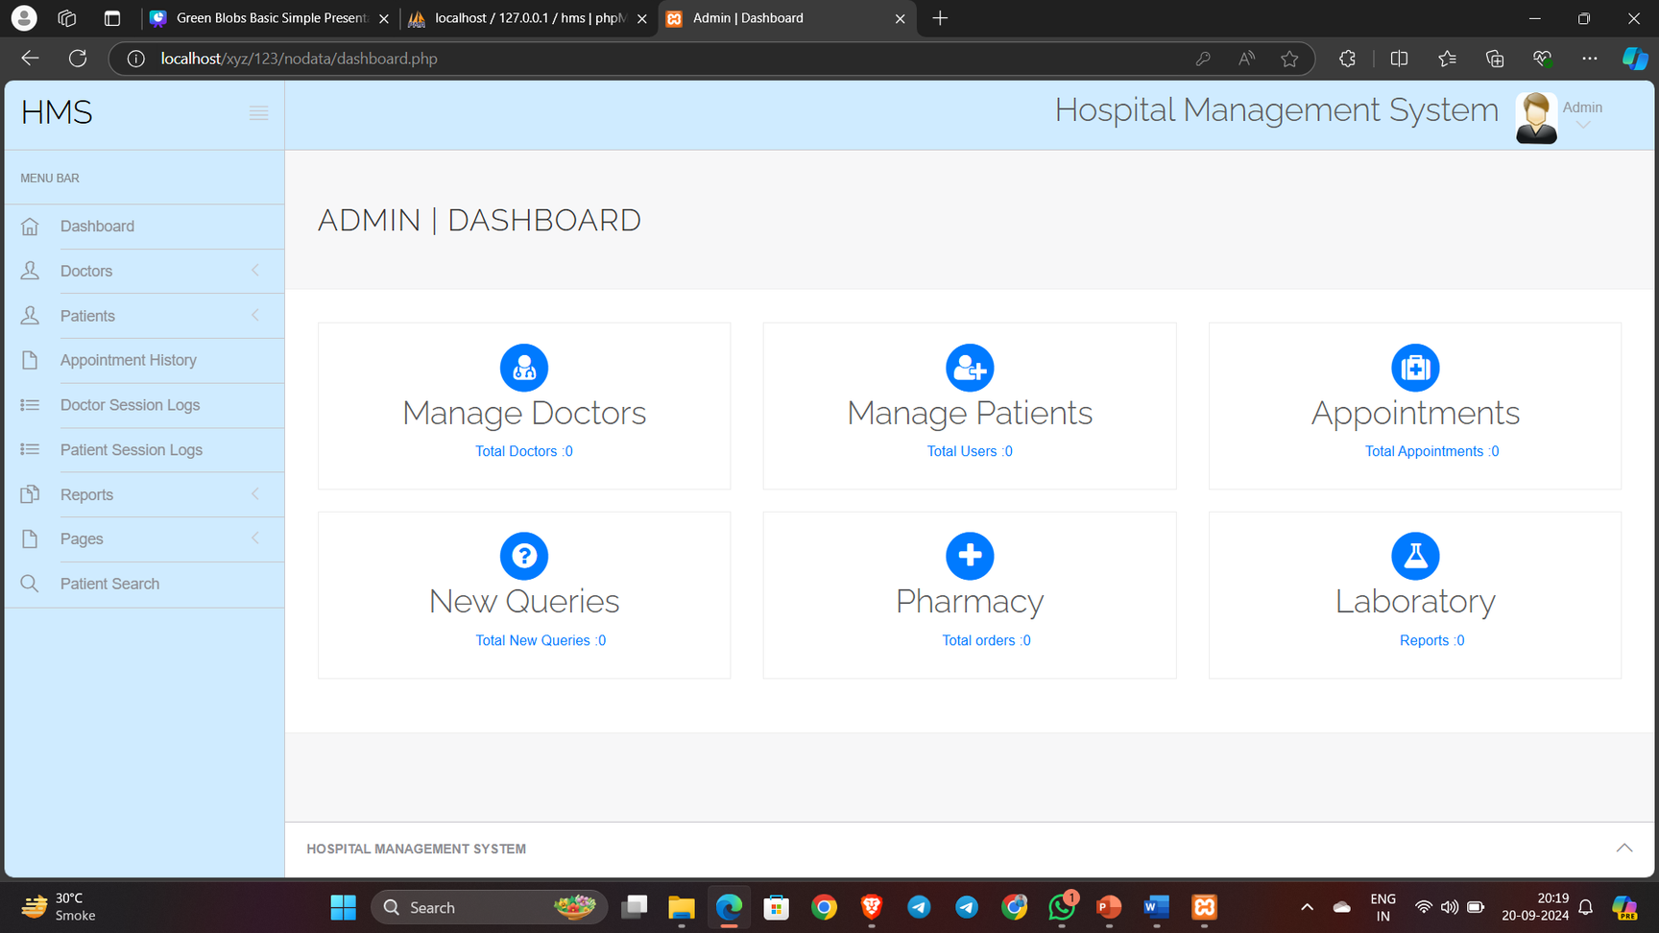
Side nav Bar

Slide 45
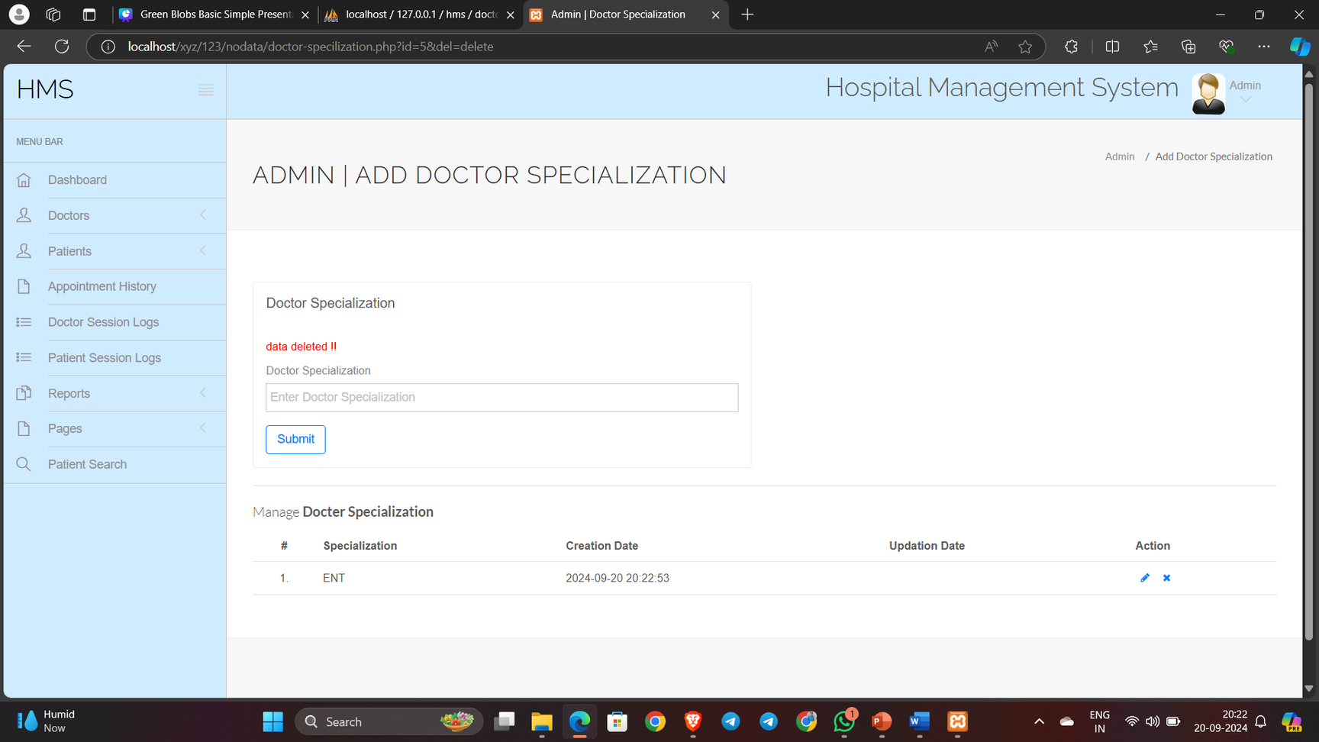
Doctor Specialization Ui

Slide 46
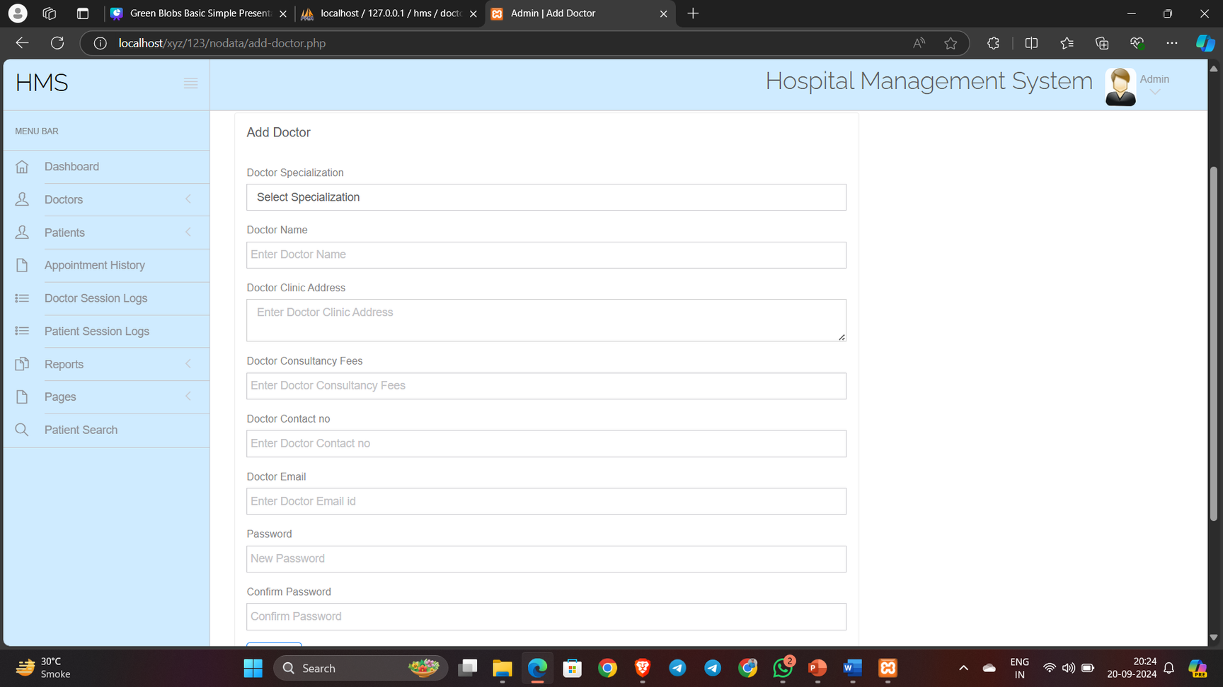
Doctor Add Ui

Slide 47
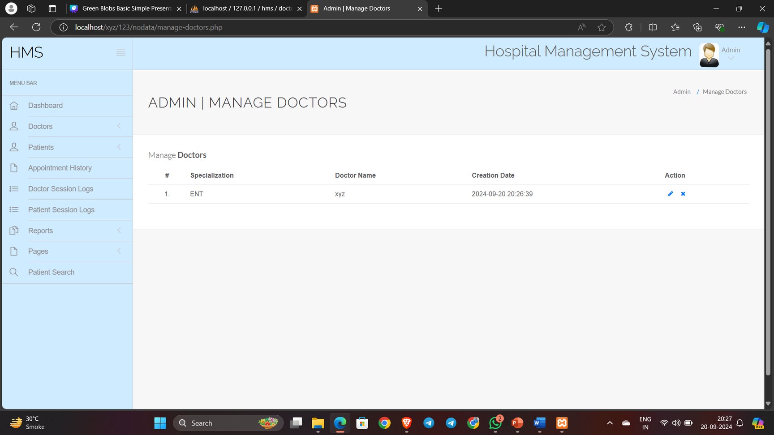
Manage Doctor Ui

Slide 48
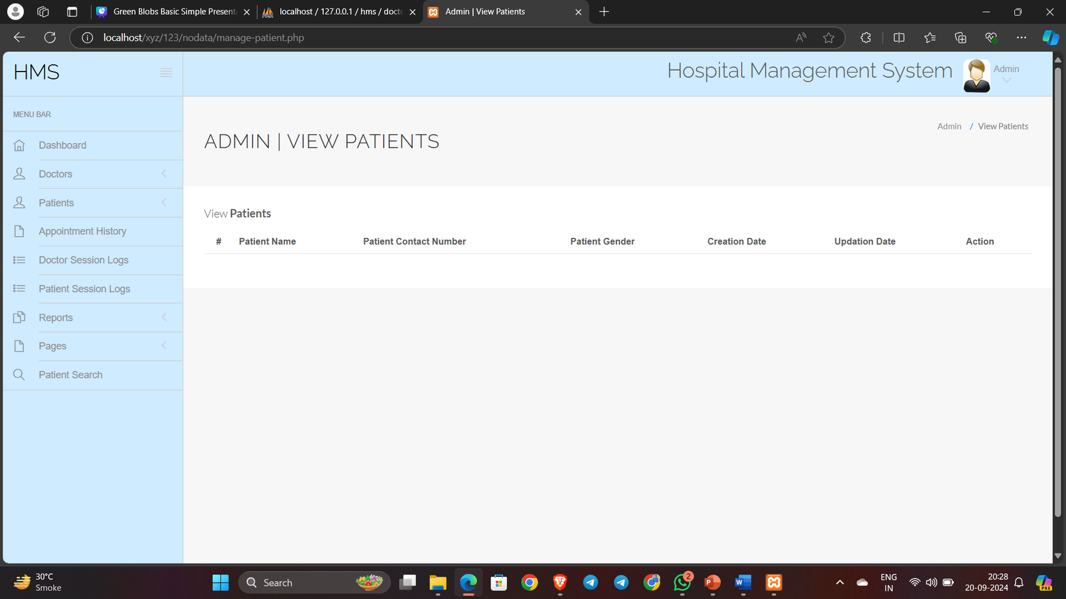
Patient Ui

Slide 49
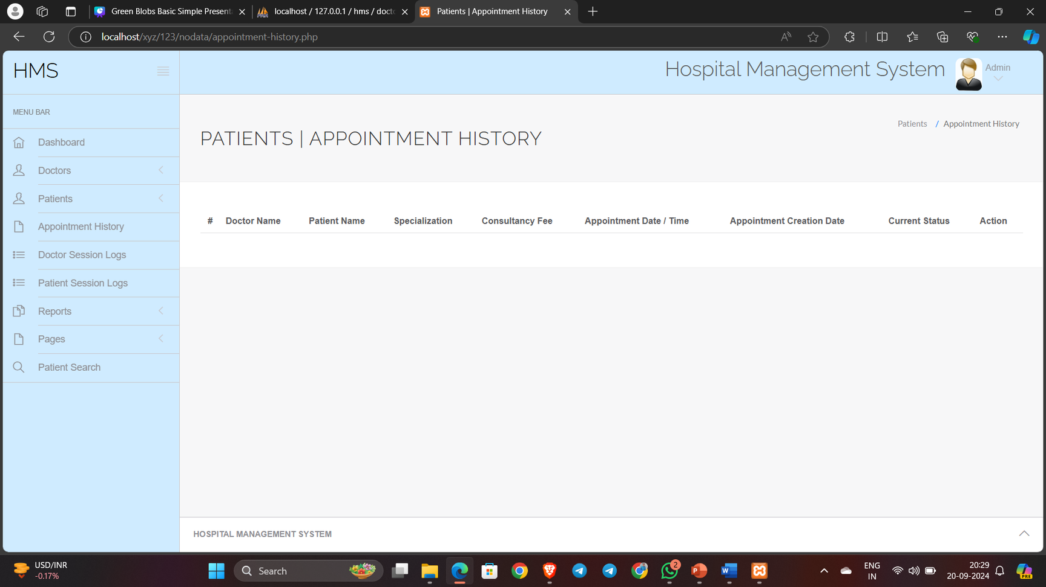
Appointment Ui

Slide 50



THANK YOU!
Presented by
Sumitkumar Pandit & Jainam Doshi & Dharmik Chavda
sumitkumarpandit.22.imsc@iict.indusuni.ac.in

